Slide 1

SB 823 DJJ Realignment
Secure Youth Treatment Facility (SYTF)
Eduardo Calderon
Supervising Probation Officer
East Mesa Juvenile Detention Facility
Youth Development Academy (YDA)

Slide 2
Purpose and Intent of SB823
Senate Bill (SB)823 closed the Division of Juvenile Justice (DJJ) within the California Department of Corrections and Rehabilitation.
  SB823 shifted the responsibility for all youth adjudicated a ward of the Court to their committing County.

Slide 3
Principles
Justice involved-youth are more successful when they remain connected to their families and communities
Leverage the historic success of juvenile probation
Reduce transfer of young people into adult criminal justice system
Dispositions should be least restrictive appropriate environment and reduce the use of confinement through community-based response and interventions.
Notes:
Senate Bill 823(a), October 10, 2020.

Slide 4
Two Levels of SB 823
State Level
Creation of the Office of Youth & Community Restoration (OYCR).
Ombudsman with Investigatory Powers.
Research and Best Practices, Data Collection, and Technical Assistance.
Oversight of SB823 Grant Programs.
County Level
Creation of Secure Youth Treatment Facility (SYTF).
Youth Development Academy (YDA)
Local jurisdiction: Age 23/25
Local Confinement Jurisdiction: Age 25

Slide 5
Age Extensions
Extension of Juvenile Jurisdiction
SB823 extends the age of local juvenile Court jurisdiction for youth adjudicated of 707(b) offenses to age 23.
If the 707(b) offense would have carried an adult sentence of seven years of more, the age is extended to 25.
Extension of Age of Local Confinement
SB823 will allow for youth whose case originated in juvenile court to remain in juvenile hall until age 21 pending disposition of their case, unless criteria is met under WIC208.5 to transfer youth to adult facility.
For youth adjudicated of a serious and violent offense that is committed to SYTF to remain in local juvenile facility up to the age of 25.
Notes:
Welfare and Institutions Code § 607. 5.
Welfare and Institutions Code § 208.

Slide 6
32 youths returned from DJJ to local custody
  Average Age: 19.3
  Length of time remaining: 3-4 years
  Typical charges:
    Murder/Attempted Murder (16), Voluntary Manslaughter (3), Robbery (3), Mayhem/Aggravated Mayhem (2), Assault with a deadly weapon (2), Shooting at an Inhabited Vehicle (2), Carjacking – use of weapon (1), Kidnapping for Robbery (1)
26 additional youths committed directly to the program since its inception
51 currently in custody
This program creates staffing requirements of approximately 15 officers per unit
The program currently occupies 3 units at EMJDF, expanding to 4 next month and expected to continue until 6 units are dedicated
Has increased the per-unit population within pre-disposition juvenile hall units
Local Impact

Slide 7

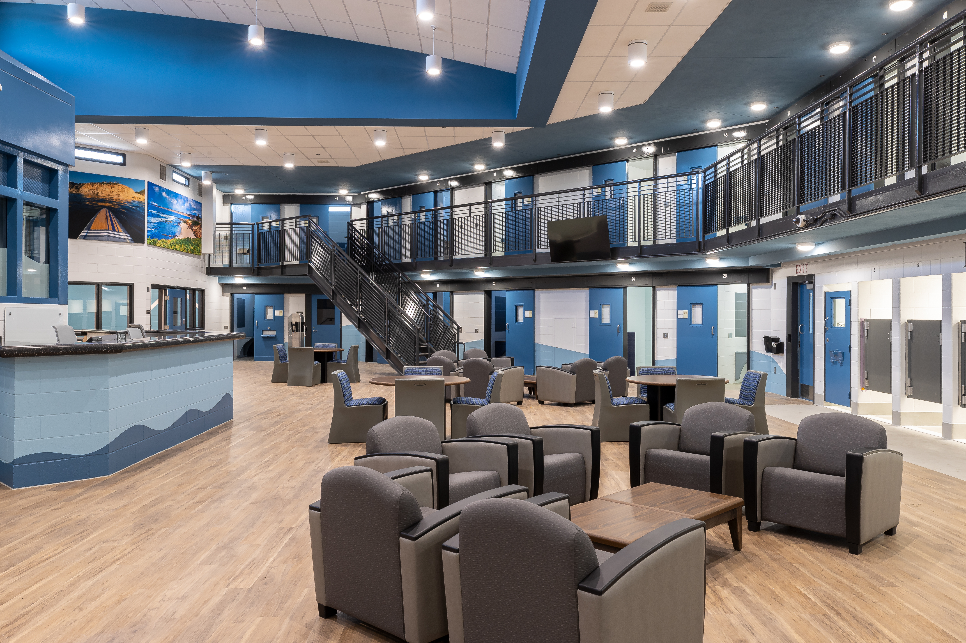
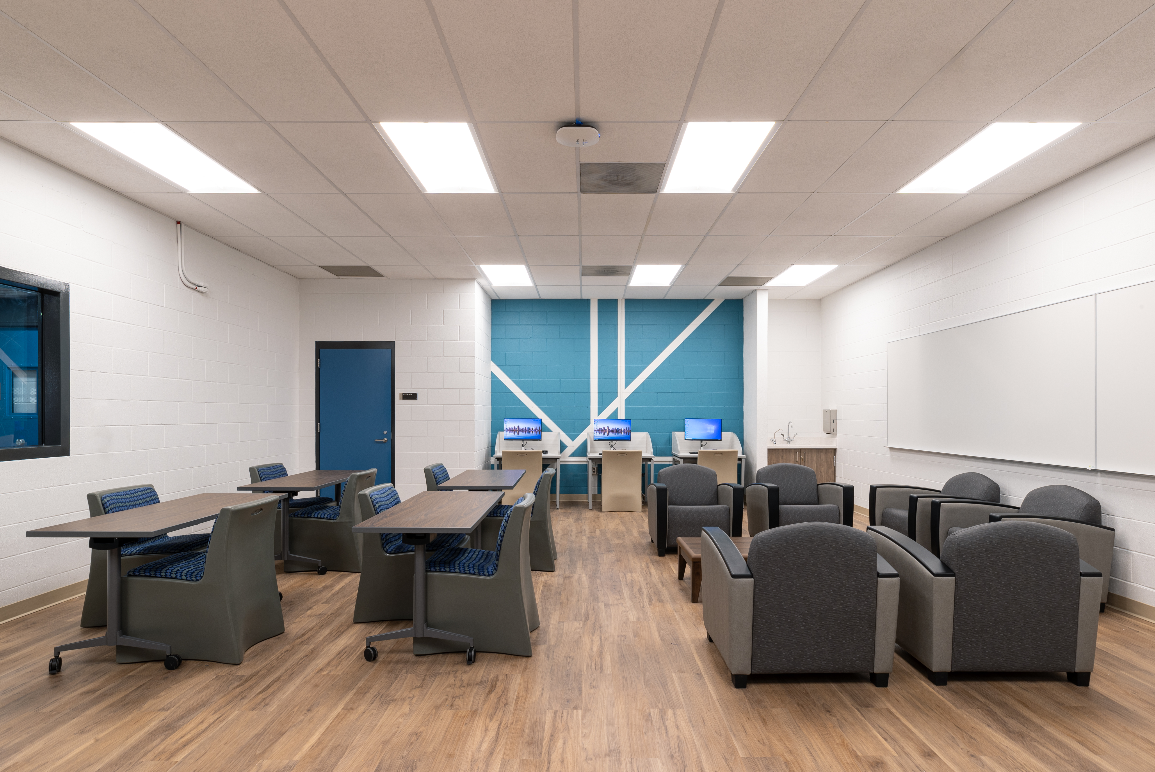

Youth Development Academy
YDA is a Secure Youth Treatment Facility (SYTF) identified to meet the requirements of SB823 juvenile justice realignment.
The program structure is designed to support the principles of trauma-informed, culturally responsive care and a developmental approach to youth rehabilitation.
Commitments range from 18 months to 7 years.
Notes:
YDA was developed in collaboration with the Juvenile Justice Coordinating Council and reflects a shared vision to serve this population closer to home. Replaces the California Division of Juvenile Justice (formerly known as CYA). Our contracted partner for this program is SBCS and we have an agreement with County BHS for psychiatric and psychological services.

Slide 8
Youth Development Academy
Eligibility Requirements
14-24 years of age and who have been adjudicated for a 707(b) offense, such as, but not limited to:
  Murder
  Voluntary Manslaughter
  Robbery
  Sexual Offenses
  Kidnapping
  Rape
  Assault with a Deadly Weapon other than firearm or Great Bodily Injury
Notes:
As a replacement for DJJ, this program is designed to serve the “deep end” of the juvenile justice system, youths who have committed the most serious offenses.

Slide 9
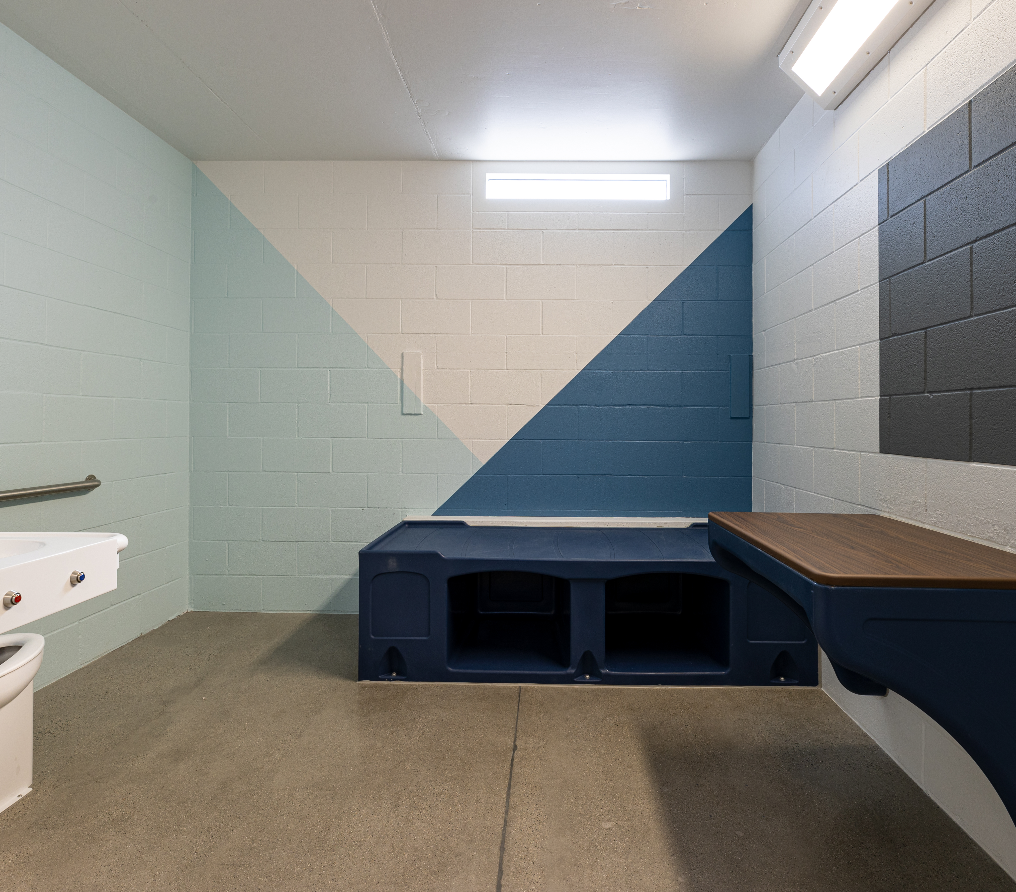
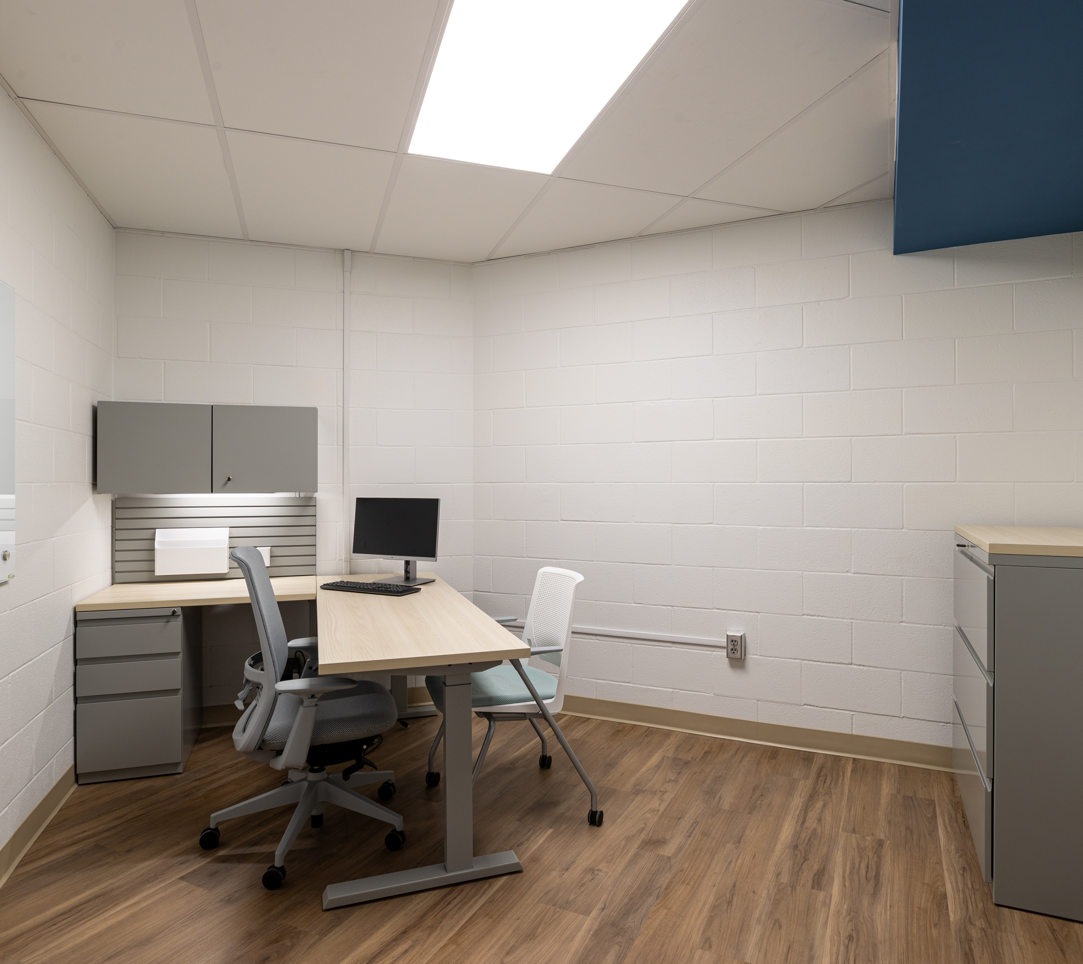
Softening Remodel
Because of the longer commitments associated with the most serious offenses, facility interiors are being improved to offer more homelike furnishings, softer bedding, rugs and art are designed to better meet foundational needs and increase amenability to treatment.
Notes:
The facility was originally designed to operate as a juvenile hall, providing short term detention for large numbers of youths. The units are being remodeled to create a more supportive environment for longer stays, with smaller populations in each unit and a variety of changes including…

Slide 10
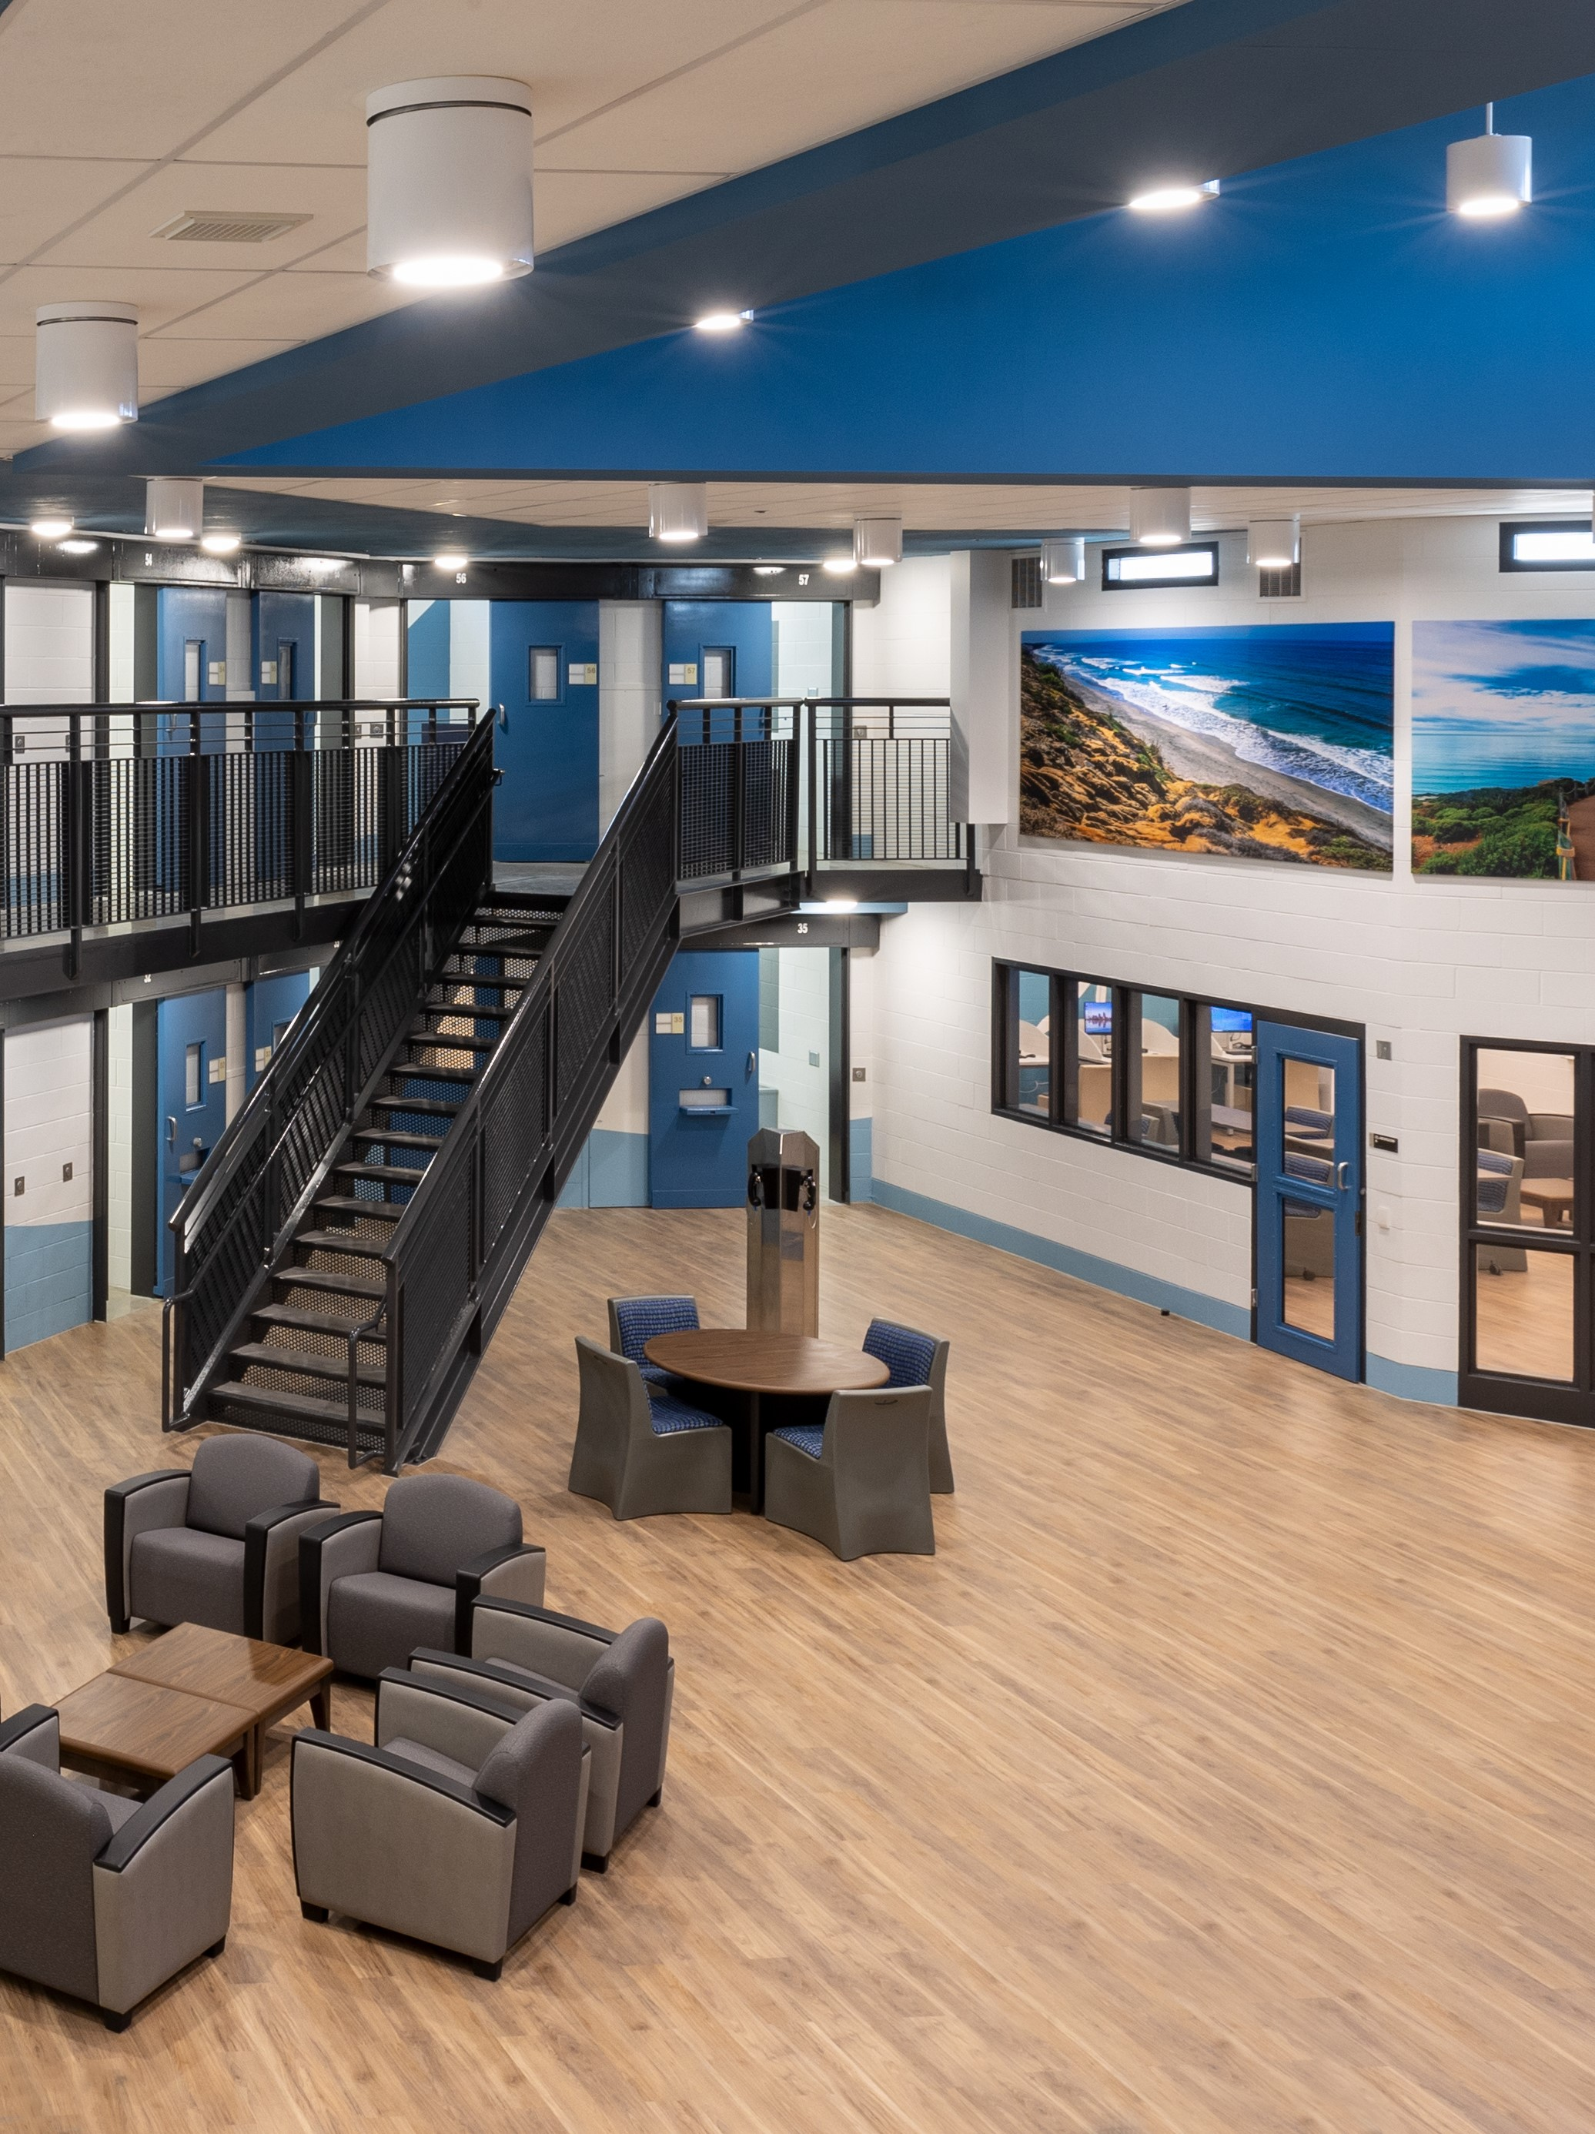
YDA Services Include
Trauma Focused Cognitive Behavioral Therapy (TF- CBT)
Dialectical Behavioral Therapy
Life Skills
Mindfulness
Stress Management
Southwestern College
A New Direction
Mid-City Music and Art
San Diego Workforce Partnership
David’s Harp Foundation
Restorative Justice Mediation Program (RJMP)
Men of Honor
Victim Impact
Juvenile Justice Advocates of California (JJAC)
Project AWARE (Restorative Practices)
Mindfulness
Thinking for a Change (ETA July-Aug)
Parenting
Youth Advisory Council
Religious Services
Notes:
Services are being delivered within YDA by our contracted partner SBCS. In the near future, we anticipate additional services including CTE for culinary arts, horticulture and gardening…

Slide 11
THANK YOU
For any questions, please reach out to
Matthew Strickland, Division Chief
Brandon Abriel, Division Chief
Eduardo Calderon, Supervisor

